Slide 1
Soil Health Principles

Slide 2
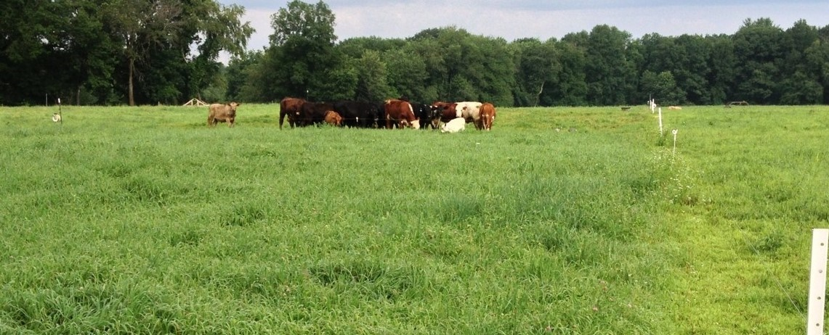
Objectives
List and explain the soil health principles
Identify and explain how conservation practices address soil health principles
Identify core soil health practices in your region
Cochrane, NRCS

Slide 3
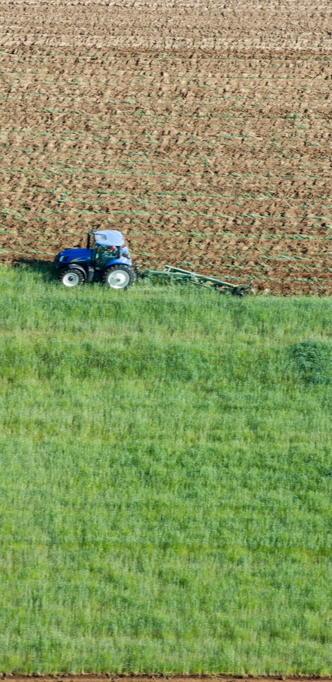
What are General Characteristics of Cultivated/Disturbed Soils?
↓ H₂O Infiltration & Storage
↓ Biological Activity
↓ Biological Diversity
↓ Efficient Nutrient Cycling
↑ Summer Temps
↓ Contribution to Vigor
↑ Erosion Potential
↑ Evaporation
↓ Aggregation
The productivity of conventional agricultural systems are maintained with increased technology, labor, fuel, nutrients, pesticides, water…
Remsberg, SARE
Notes:
[Allow class to provide answers to the title question briefly before showing – don’t spend a lot of time on each bullet as it is discussed more in depth later].
Arrows down are decreasing, arrows up are increasing
Ask the class to brainstorm desirable soil functions. These can be recorded on a board or flipchart—
Produce food and fiber
Capture and store water
Cycle nutrients
Resilient to environmental stressors
Disease inhibition

Slide 4
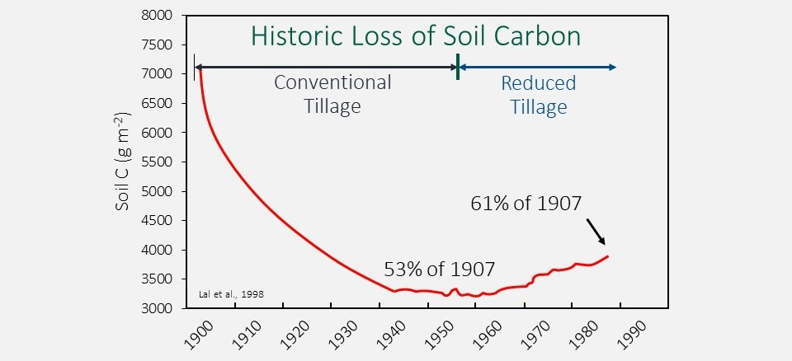
The Challenge
How can we regain soil function so that…
  Resource concerns are addressed?
  Inputs can be reduced?
  Agricultural productivity is sustainably maintained?
Is it possible to achieve all 3?
Notes:
Simulated total soil carbon changes (0 - 20 cm depth) from 1907 to 1990 for the central U.S. corn belt and a portion of the Great Plains. This indicates that soil organic carbon levels dropped to 53% of pre-cultivation levels in the 1960s and increased subsequently with the adoption of conservation tillage practices and the advent of higher yielding varieties which produce more crop residues (Lal et al., 1998 PUT IN THE SOURCE ). Not sure the increase has happened as predicted in this model.
Relate this loss in carbon to the potential of soil to sequester carbon. The soil has the potential to put back or store all this lost carbon. The potential is about 40% of the pre-cultivation soil carbon for this area.
In general, the C content of soil organic matter is about 58%. Soil organic matter is a key indicator of soil quality and is an integrated measure of change in soil function. Generally, increases in soil organic matter reflect increases in soil quality. Soil can function as a sink for atmospheric carbon, and therefore has the potential to aid in mitigating atmospheric carbon.
Is it possible to restore, to some degree, the functions that would have been found in that native systems that would have occurred in the area? WHILE maintaining productivity. SH systems will never be adopted if net income must be sacrificed.
The underlying goal of promoting SHMS is that in many situations it is possible to achieve all three of the listed outcomes.

Slide 5
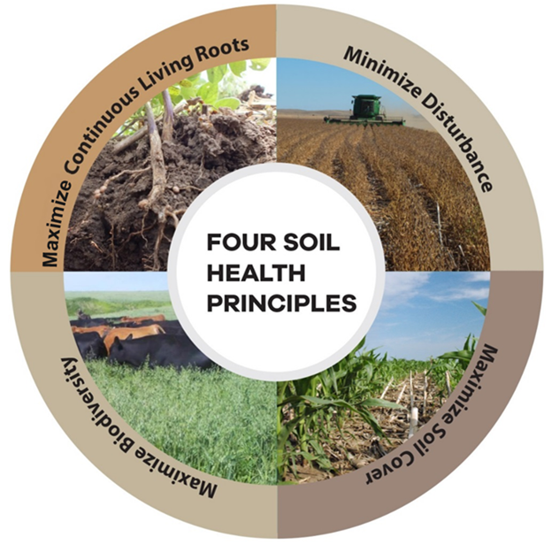
The Principles that Conserve the Soil Ecosystem
Minimize Disturbance
Maximize Cover
Maximize Biodiversity
Maximize Continuous Living Roots
SOIL HEALTH PRINCIPLES
Notes:
The soil health principles being advocated by NRCS are essentially attempting to mimic what is typically occurring in native ecosystems.
Minimizing soil disturbance, whether that is physical (tillage), chemical (excessive nutrients or pesticides) or biological (creating favorable conditions for diseases or weeds). Recognize that some, managed disturbance may be desirable. That should be managed to a minimum that meets the management objectives.
Maximize cover of the soil with living or dead plant material.
Maximize the diversity of the system. Fundamentally, this will be introducing greater temporal and spatial diversity with plants and adding grazing animals to the cropping system would be another means of increasing diversity in the system.
Maximize the time and distribution of living roots in the soil. This will be in large part dependent on climate and cropping system. Understand that the goal is have growing plants for as much of the year as practicable.
Magdoff expansion of principles (MAGDOFF, FRED.2021. Repairing the Soil Carbon Rift. Monthly review (New York, N.Y.: 1949).https://dx.doi.org/10.14452/MR-072-11-2021-04_1. )
Keeping the soil covered with living vegetation (and living roots in the ground) for as much of the year as possible by using cover crops between economic crops.
Reducing soil disturbance (tillage) using appropriate equipment, keeping crop residue on the surface.
Using complex rotations, including perennials if possible, and intercropping to provide diversity above and below ground.
Using legumes to “grow nitrogen” for grains and vegetables.
Adding appropriate amounts of varied sources of organic matter on a regular basis by growing high biomass crops and cover crops, or bringing materials such as manures, composts of manures, and kitchen wastes to the fields.
Integrate animals into cropping systems.

Slide 6
List the most common practices that are used in your area.
Notes:
[Depending on time constraints, and the preference of the presenter, this discussion can be done here, before the participants are exposed to the list of practices and again afterwards, or it can be done just once at the end of the module]. Take about 7 minutes time: Lead discussion on the practices that are most commonly used in your area, and what principles those practices address. Out of these what would you consider the “core” practices?
Be sure to address all LANDUSES! Do not just focus on soil in cropland. All practices.
You can have them type them in the chat or can create a poll if you are doing this module online

Slide 7
Soil Health Principles to Support High Functioning Soils
Maximize Living Roots
Minimize Disturbance
Maximize Soil Cover
Maximize
Biodiversity
Feed
Fuel Soil Biology
Improve Resilience
Improve SOM
Protect
Soil Aggregates
Organism Habitat
SOM
Notes:
[Slides 9-13 discuss the Protect side of the principles and slides 14-16 discuss the Feed side of the principles.]
Briefly mention biology here there is a module following on biology benefits
Soil organisms are driving the benefits obtained through achieving and improving the condition of the principles. Therefore, the principles can be viewed from the perspective of how they benefit the soil ecosystem.
Feed diverse, continuous inputs (C sources, energy). The “feeding” benefits to the soil community arise predominantly from roots and diversity.
Protect habitat (aggregates and organic matter). The “protecting” benefits to the soil community arise predominantly from disturbance and cover.
Maintain SOM & aggregates; Reduce erosion & runoff risk
Buffer temperature; Reduce evaporation
Feed: Break disease cycles; Stimulate microbial diversity; Increase SOM and nutrient cycling
Enhance plant growth; Increase predator & pollinator populations

Slide 8
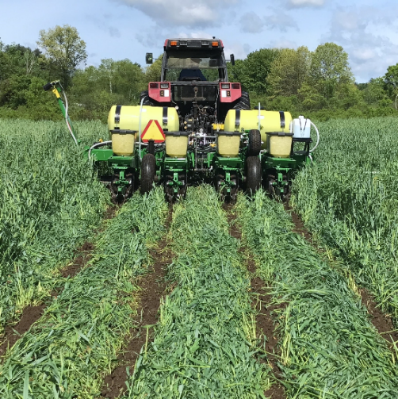
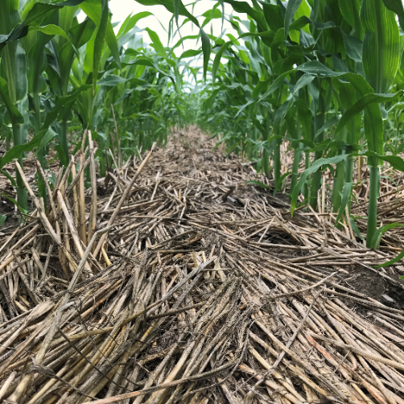
How Soil Health Principles Support Soil function – PROTECT
Maintain stable aggregates
Manage erosion
Buffer temperature
Reduce evaporation
Maintain soil organic matter
Minimize Disturbance
Maximize Soil Cover
Notes:
Have the students List the benefits before exposing to get interaction.
Students should have come up with some version of these benefits from minimizing disturbance and maximizing cover.
As needed, have open discussion of these “protecting” benefits that arise from implementing minimum disturbance and maximized soil cover.

Slide 9
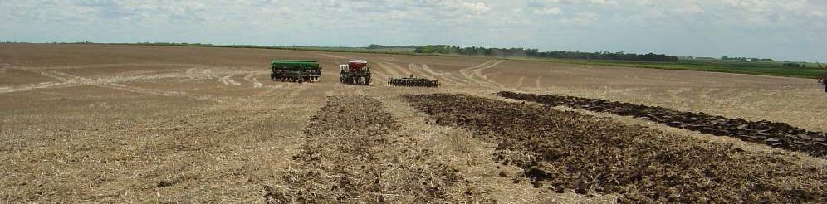
Minimize Disturbance
Excessive (chronic) Disturbance can:
  ↓Habitat for soil organisms
  Destroy soil structure
What Types of Disturbance are Common in Agriculture?
  Physical (tillage)
  Chemical (fertilizer, pesticides, soil amendments)
  Biological (grazing, non grazing, fallow systems, monoculture community)
Dr. Don Reicosky
Undisturbed
Moldboard Plow
Low Disturbance
Drill
High Disturbance
Drill
Disc
Harrow
Notes:
Who can name some types of disturbance?...
Disturbance are not necessarily negative or positive, but how they are managed
The principle of disturbance should be to optimize the disturbance

Slide 10
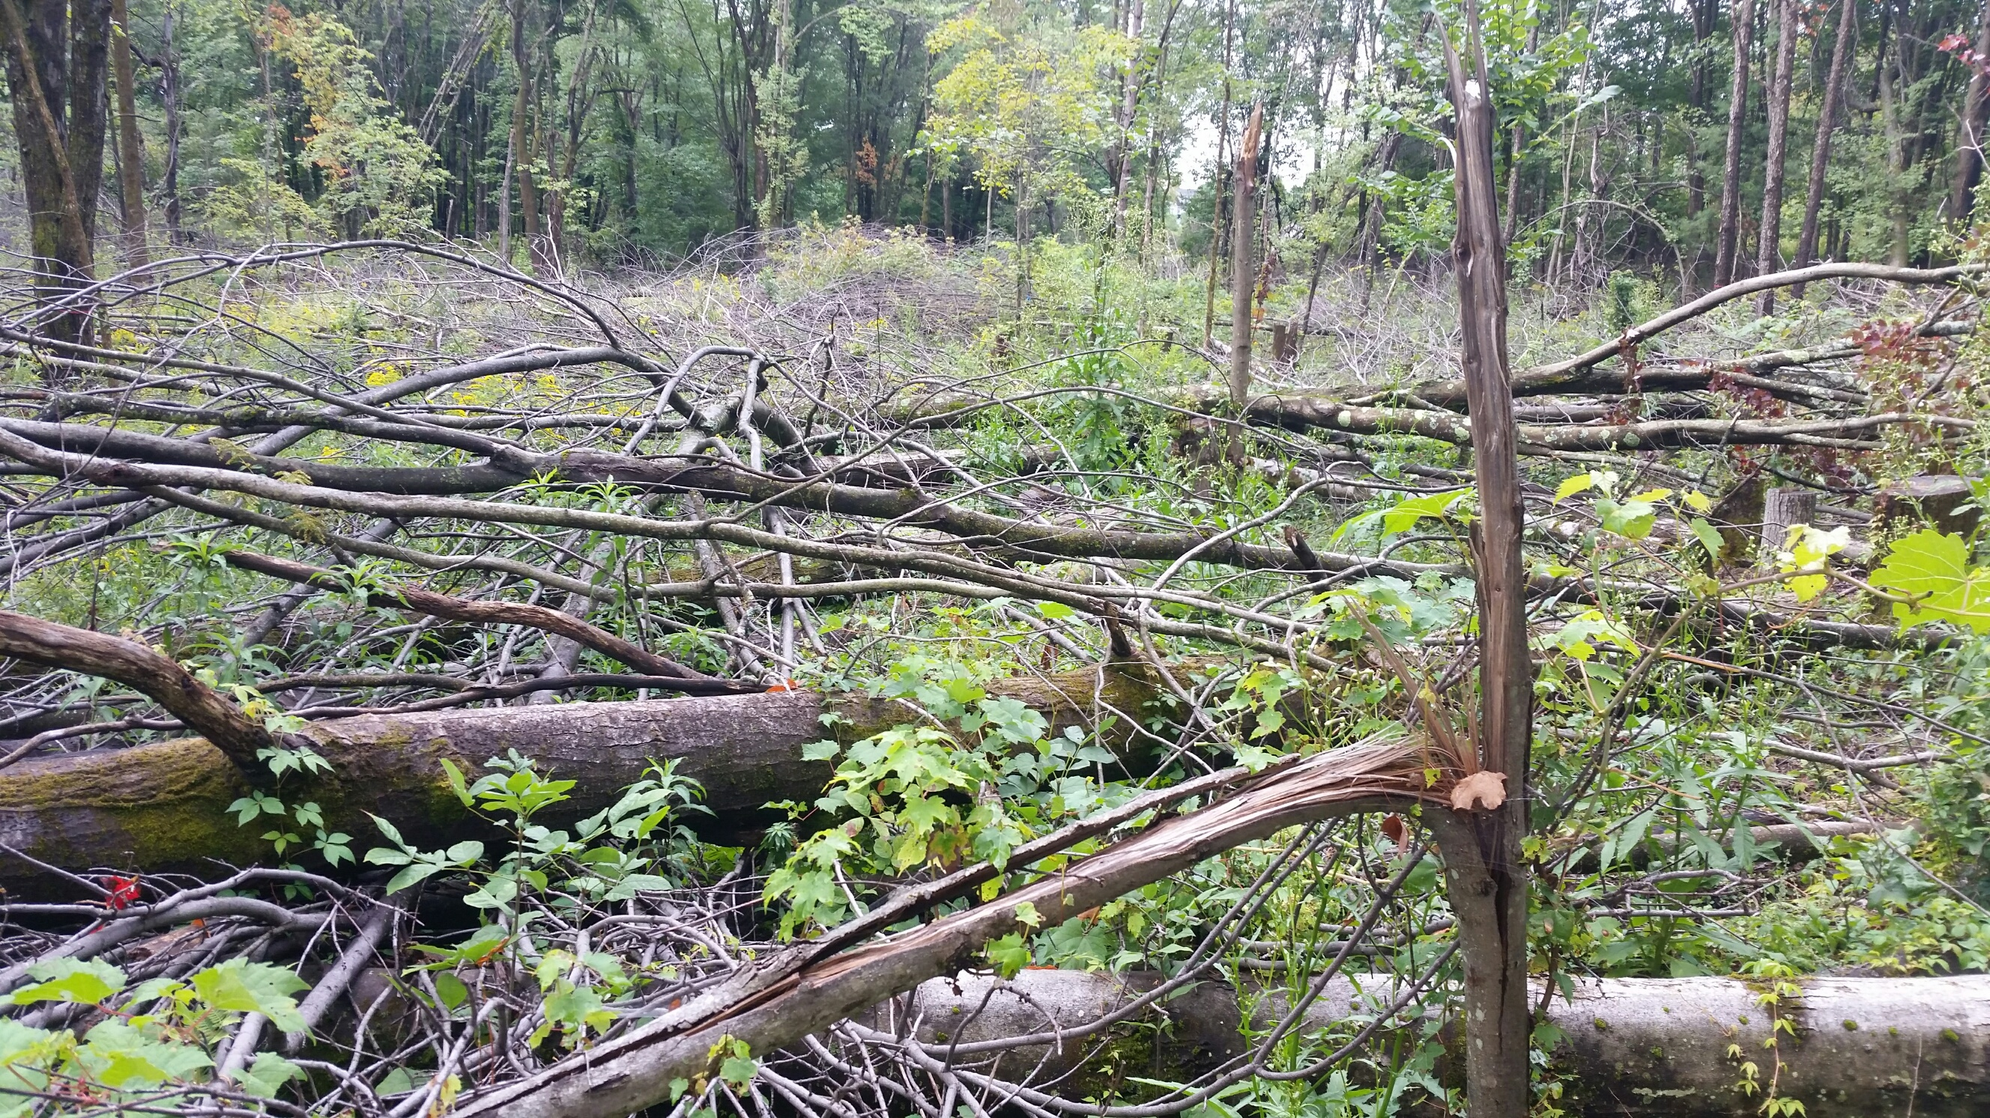
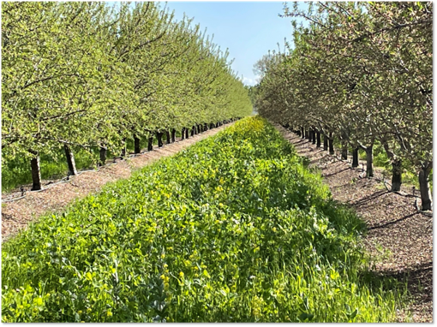
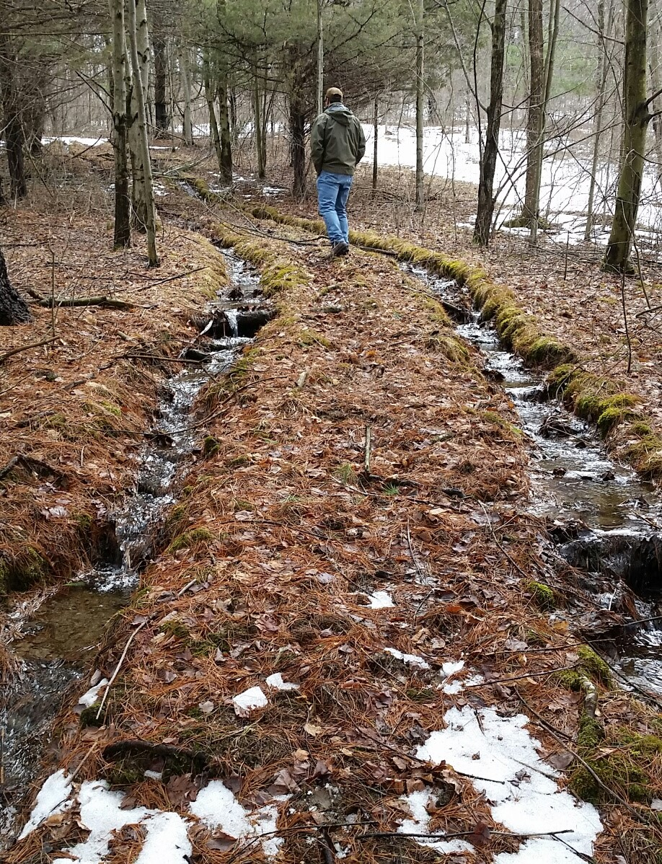
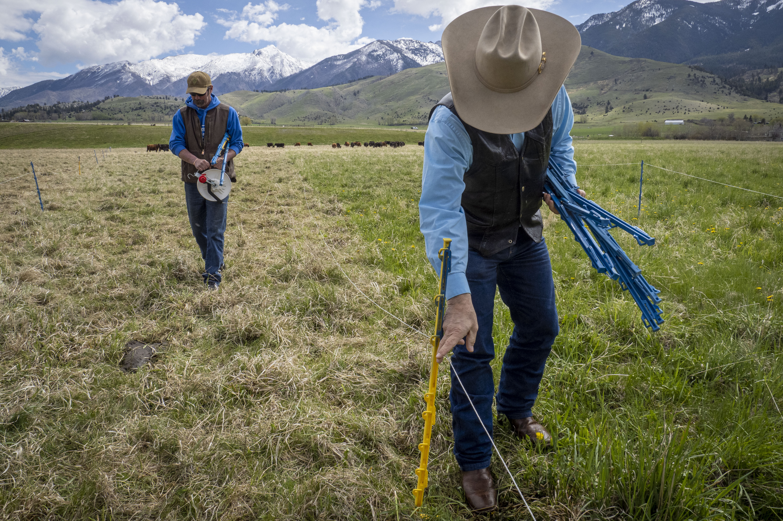
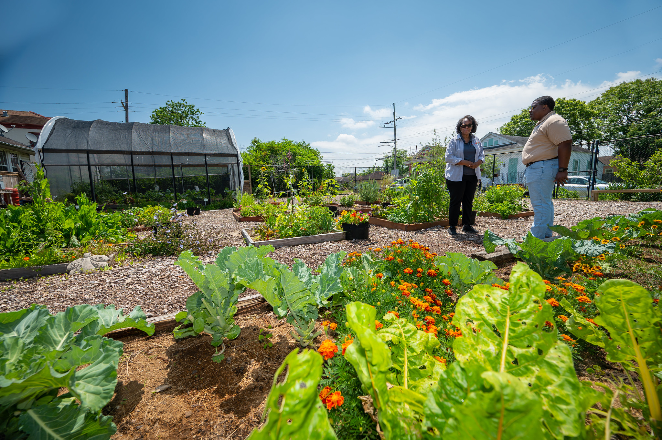
Minimize Disturbance
Notes:
All photos from USDA Flicker
Upper left leaving forest covered with woody debris
Upper right seeding interrow to a cover crop
Bottom left strip grazing optimizes the disturbance of the stand and adequate cover is left behind
Bottom right urban farm walkways are mulched and beds are mulched with cover

Slide 11
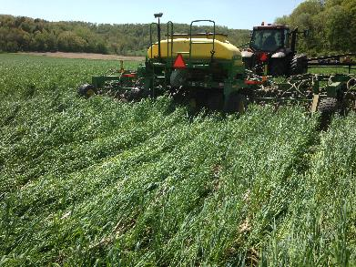
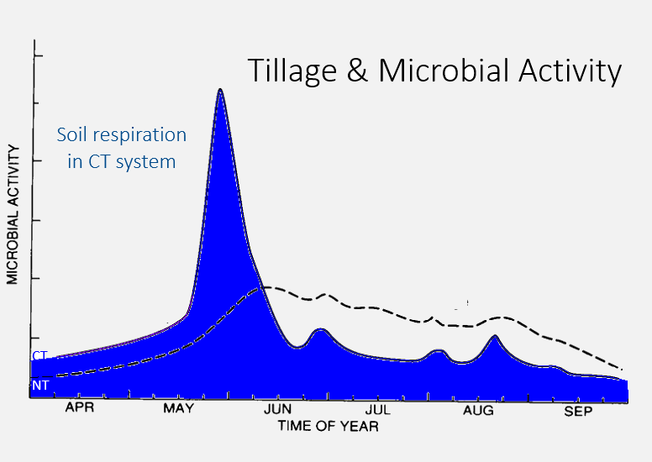
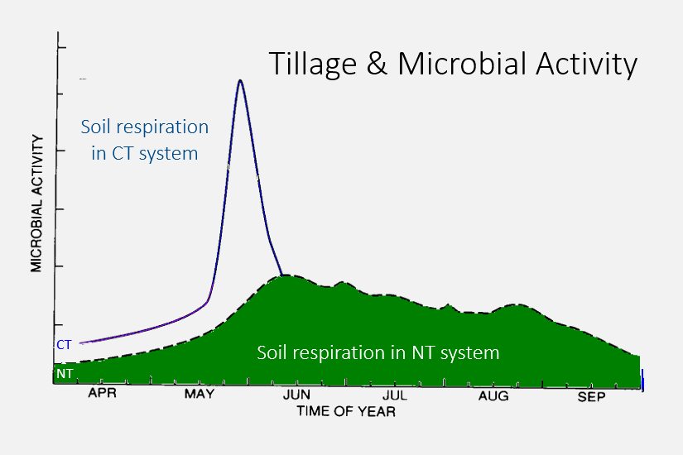
What Practices Minimize Disturbance?
Residue & Tillage Mgmt. (329/345)
Conservation Cover (327)
Pasture Hayland Planting (512)
Nutrient Mgmt. (590)
IPM (595)
Prescribed Grazing (528)
Roads, Trails and Landings (561)
Fence (382)
Photo: Echo –Y Farms
Notes:
Feed diverse, continuous inputs (C sources, energy)
Protect habitat (aggregates and organic matter)
Maintain SOM & aggregates; Reduce erosion & runoff risk
Buffer temperature; Reduce evaporation
Feed: Break disease cycles; Stimulate microbial diversity; Increase SOM and nutrient cycling
Enhance plant growth; Increase predator & pollinator populations

Slide 12
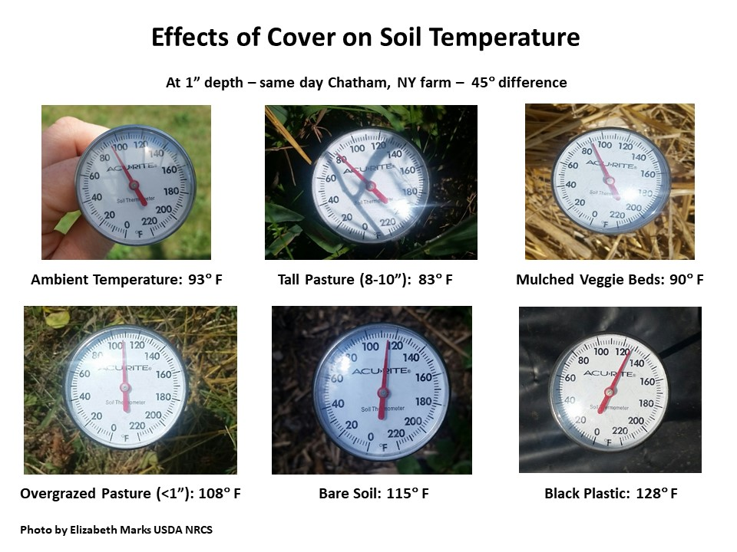
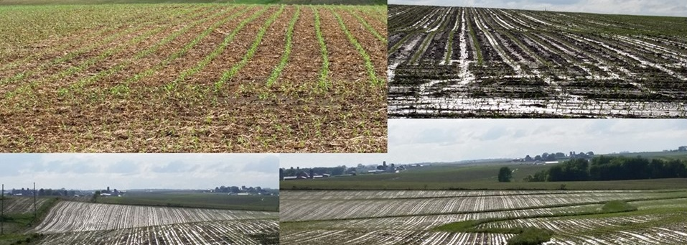
Why Maximize Soil Cover?
↓ Erosion
↑ Infiltration
↓ Evaporation
Moderate Soil Temp
Habitat for Soil Organisms ↑
Food for Biota ↑
Mitigate Compaction from Machines & Livestock
Notes:
[This set of pictures taken by Neil Sass in NE Iowa was taken at a Stop sign looking in four different directions on the same day.] you can choose a different photo for here if you are not in a cropland environment (USE A COMPARISON)
↔ is a sign for moderates or is transported
We should look at optimizing the right amount of cover,
Look at the optimal C:N ratios

Slide 13
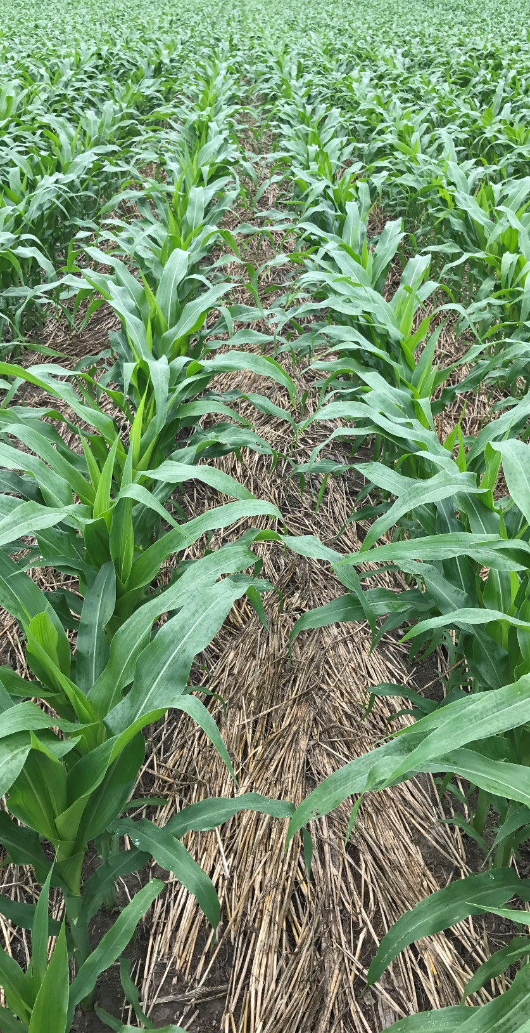
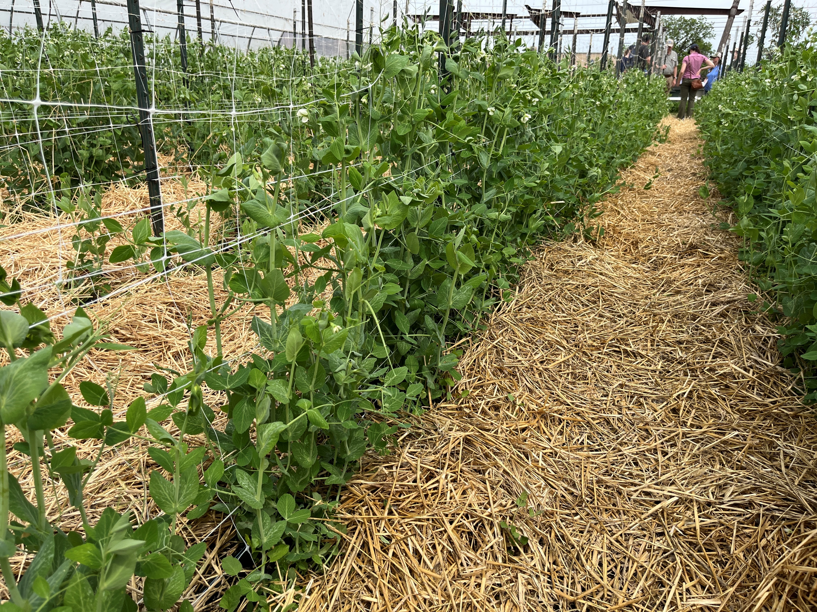
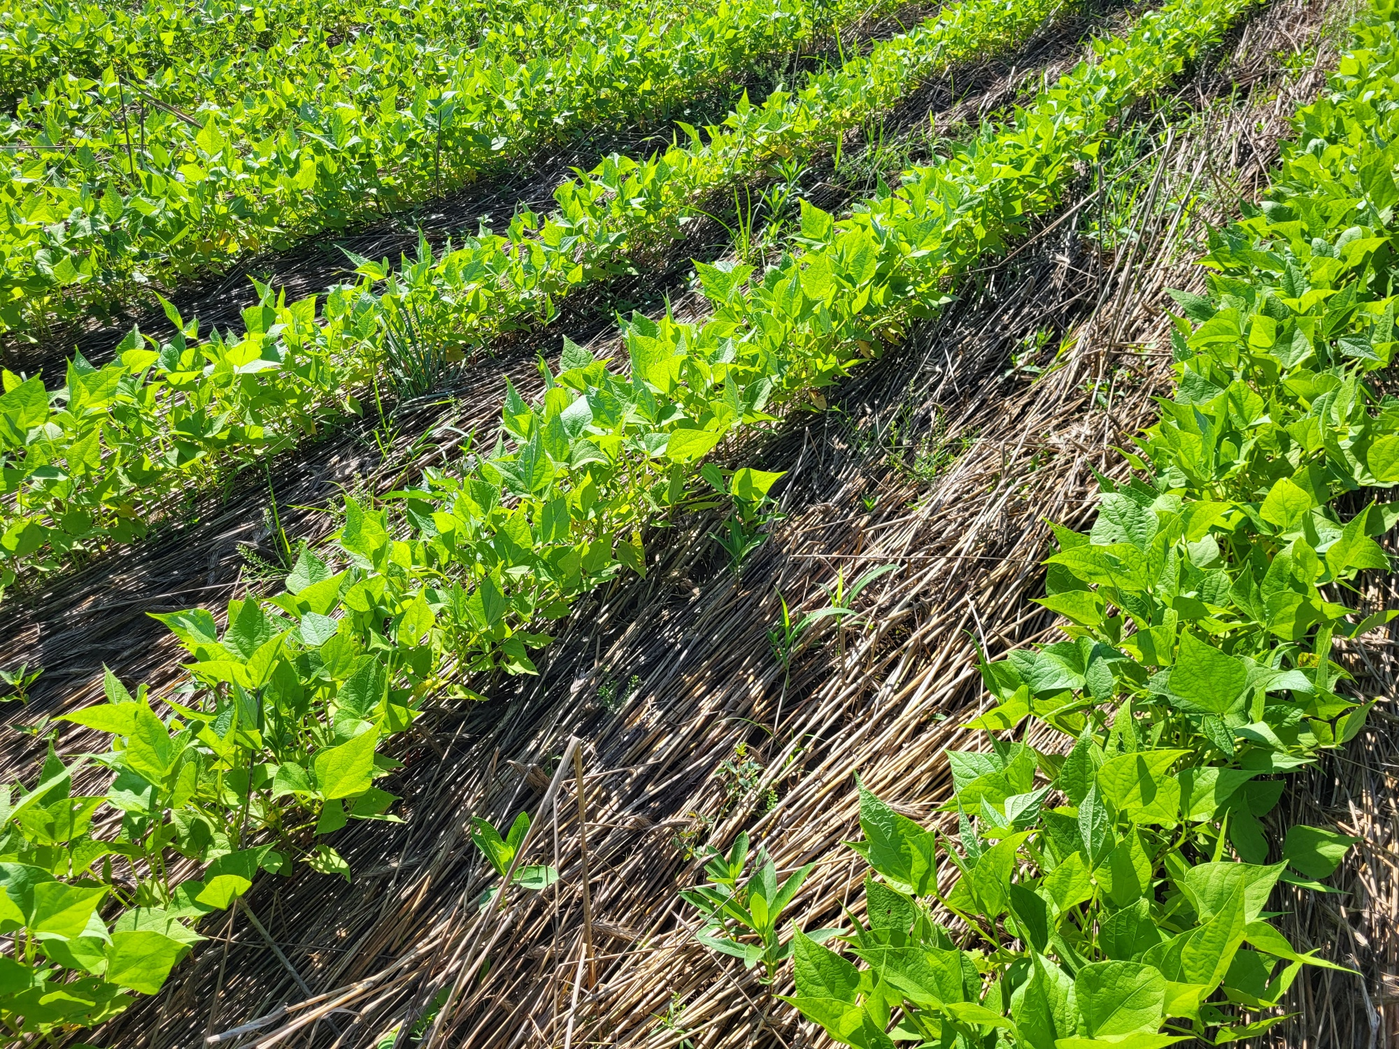
What Practices Maximize Soil Cover?
Cover Crop (340)
Residue & Tillage Mgmt. (329/345)
Conservation Cover (327)
Mulching (484)
Controlled Traffic (334)
Pasture Hayland Planting (512)
Wildlife Habitat Planting (420)
Prescribed Grazing (528)
Cochrane, NRCS
Notes:
Ask them to name them if they can. Post in chat or make a poll.

Slide 14
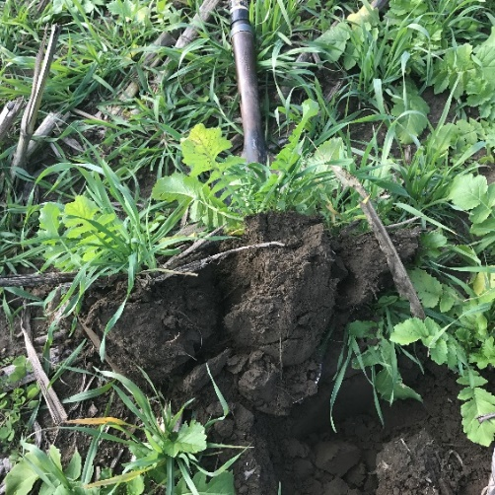
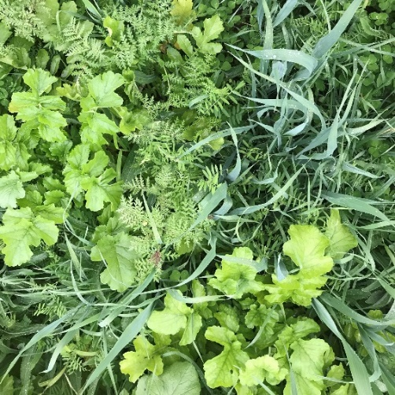
How Soil Health Principles Support Soil Function – FEED
Stimulate below-ground diversity
Increase SOM
Improve nutrient cycling
Enhance plant growth
Break pest cycles
Increase predator & pollinator populations
Maximize Living Roots
Maximize
Biodiversity
Notes:
Ask them to list them in the chat or make a poll then show,
Students should have come up with some version of these benefits from maximizing biodiversity and living roots.
As needed, have open discussion of these “protecting” benefits that arise from implementing diversity and roots.
**This would be a good place to emphasize that the appropriate implementation of each of the principles into a system helps to achieve the desired soil function benefits, i.e., planting cover crops and continuing to till a continuous corn system will not get us there.

Slide 15
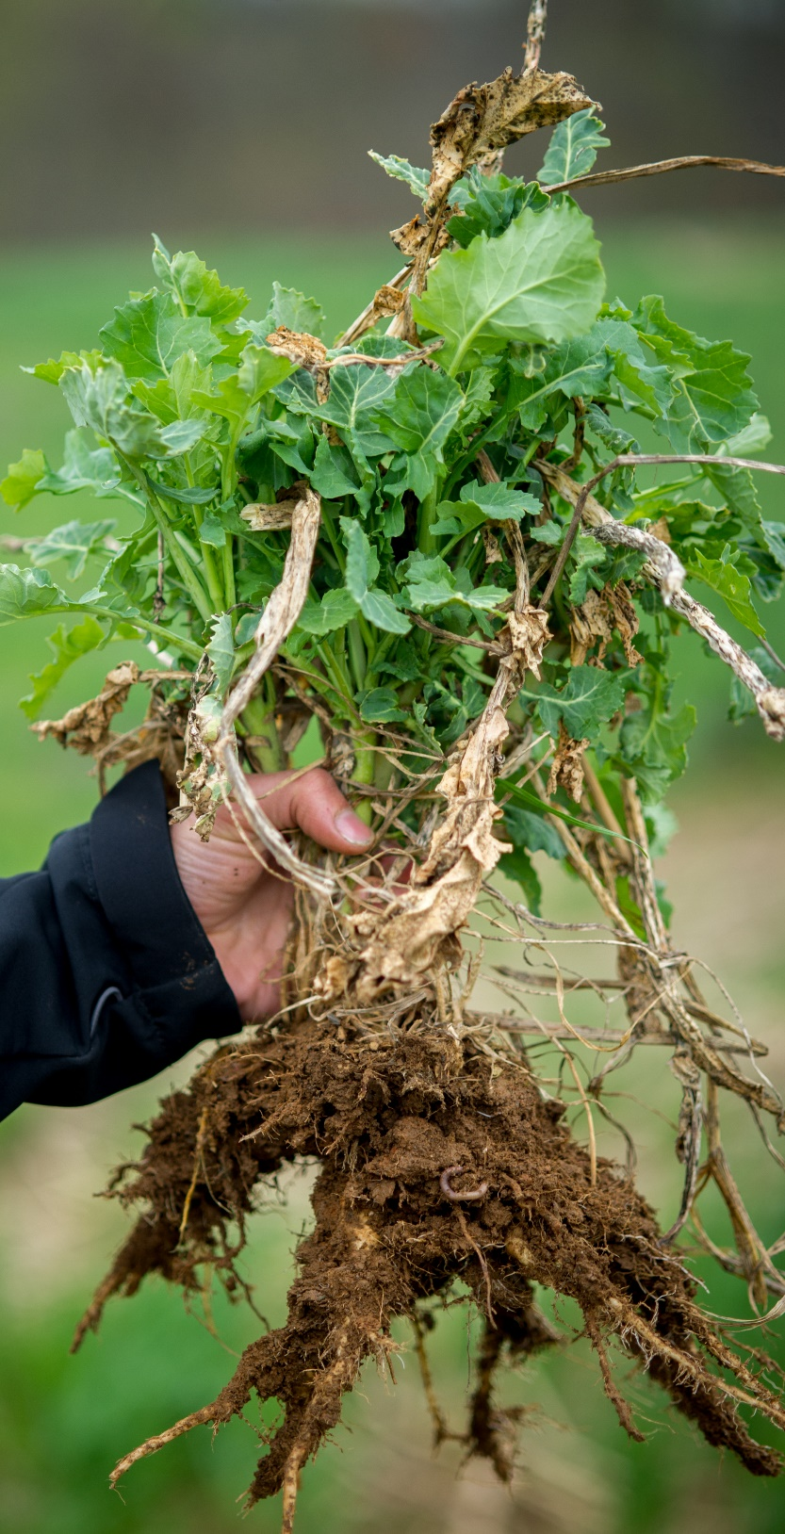
How Do We Maximize Living Roots?
Avoid fallow & ↓ re-cropping interval
↑ time in perennial crops
Manage rotations & forage height
Maximize plant spacing i.e. range, forest
What Practices?
Conservation Crop Rotation (328)
Conservation Cover (327)
Cover Crop (340)
Pasture Hayland Planting (512)
Prescribed Grazing (528)
Tree and Shrub Estb. (612)
Wildlife Habitat Plantings (420)
Remsberg, SARE
Notes:
Explain why important to maximize plant spacing more plants per sq ft = more roots per sq ft

Slide 16
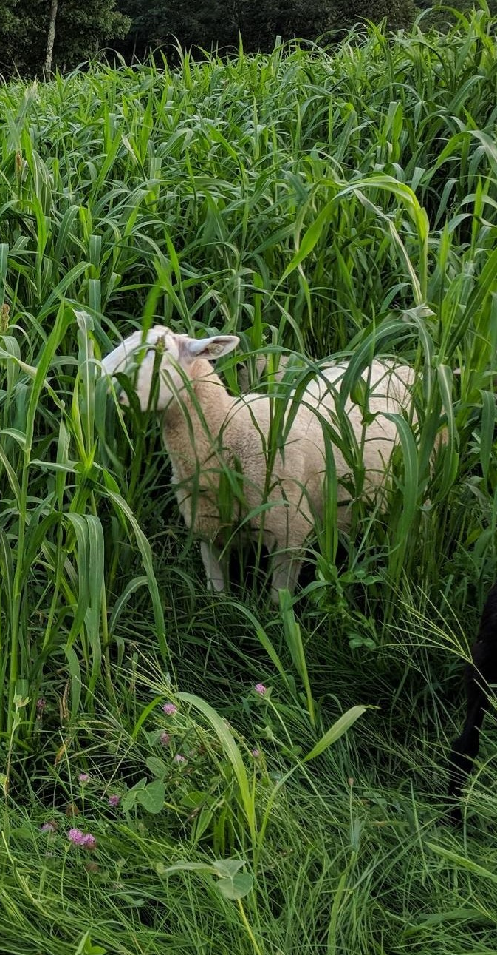
How Do We Maximize Biodiversity?
Grow diverse cover crops: grasses, forbs & legumes
↑ diversity of crop rotations
Integrate livestock & graze cover crops
↑ time in diverse perennials
Thinning to promote open space and plant diversity
What Practices?
Conservation Crop Rotation (328)
Conservation Cover (327)
Cover Crop (340)
Pasture Hayland Planting (512)
IPM (595)
Prescribed Grazing (528)
Wildlife Habitat Plantings (420)
Fosher, NHACD
Notes:
Forest Stand Improvement (666) fits the thinning scenario above.
Tree Shrub Est. (612)

Slide 17
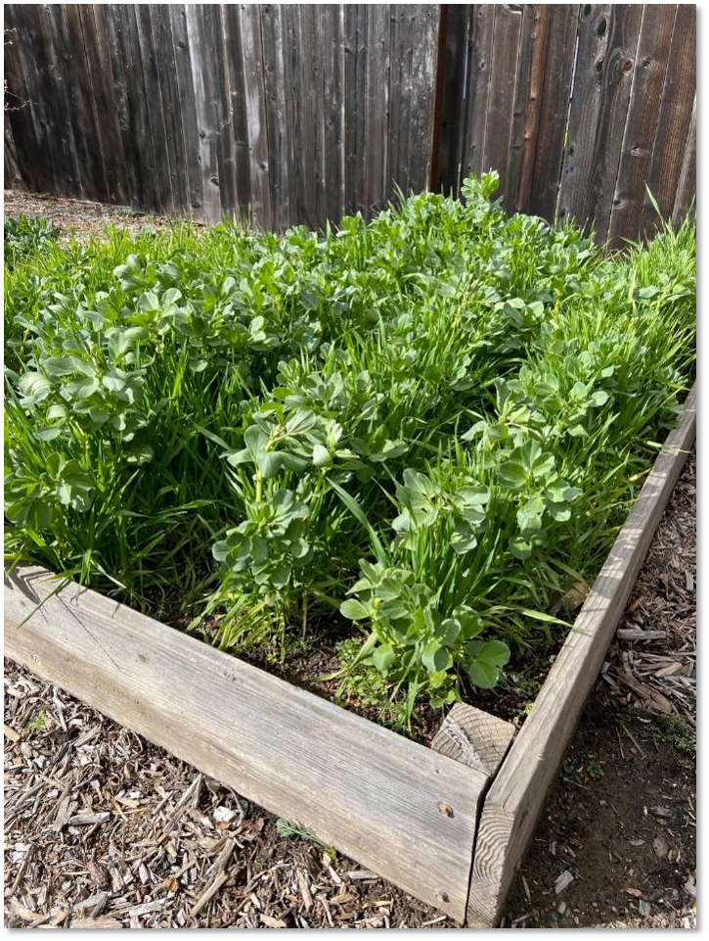
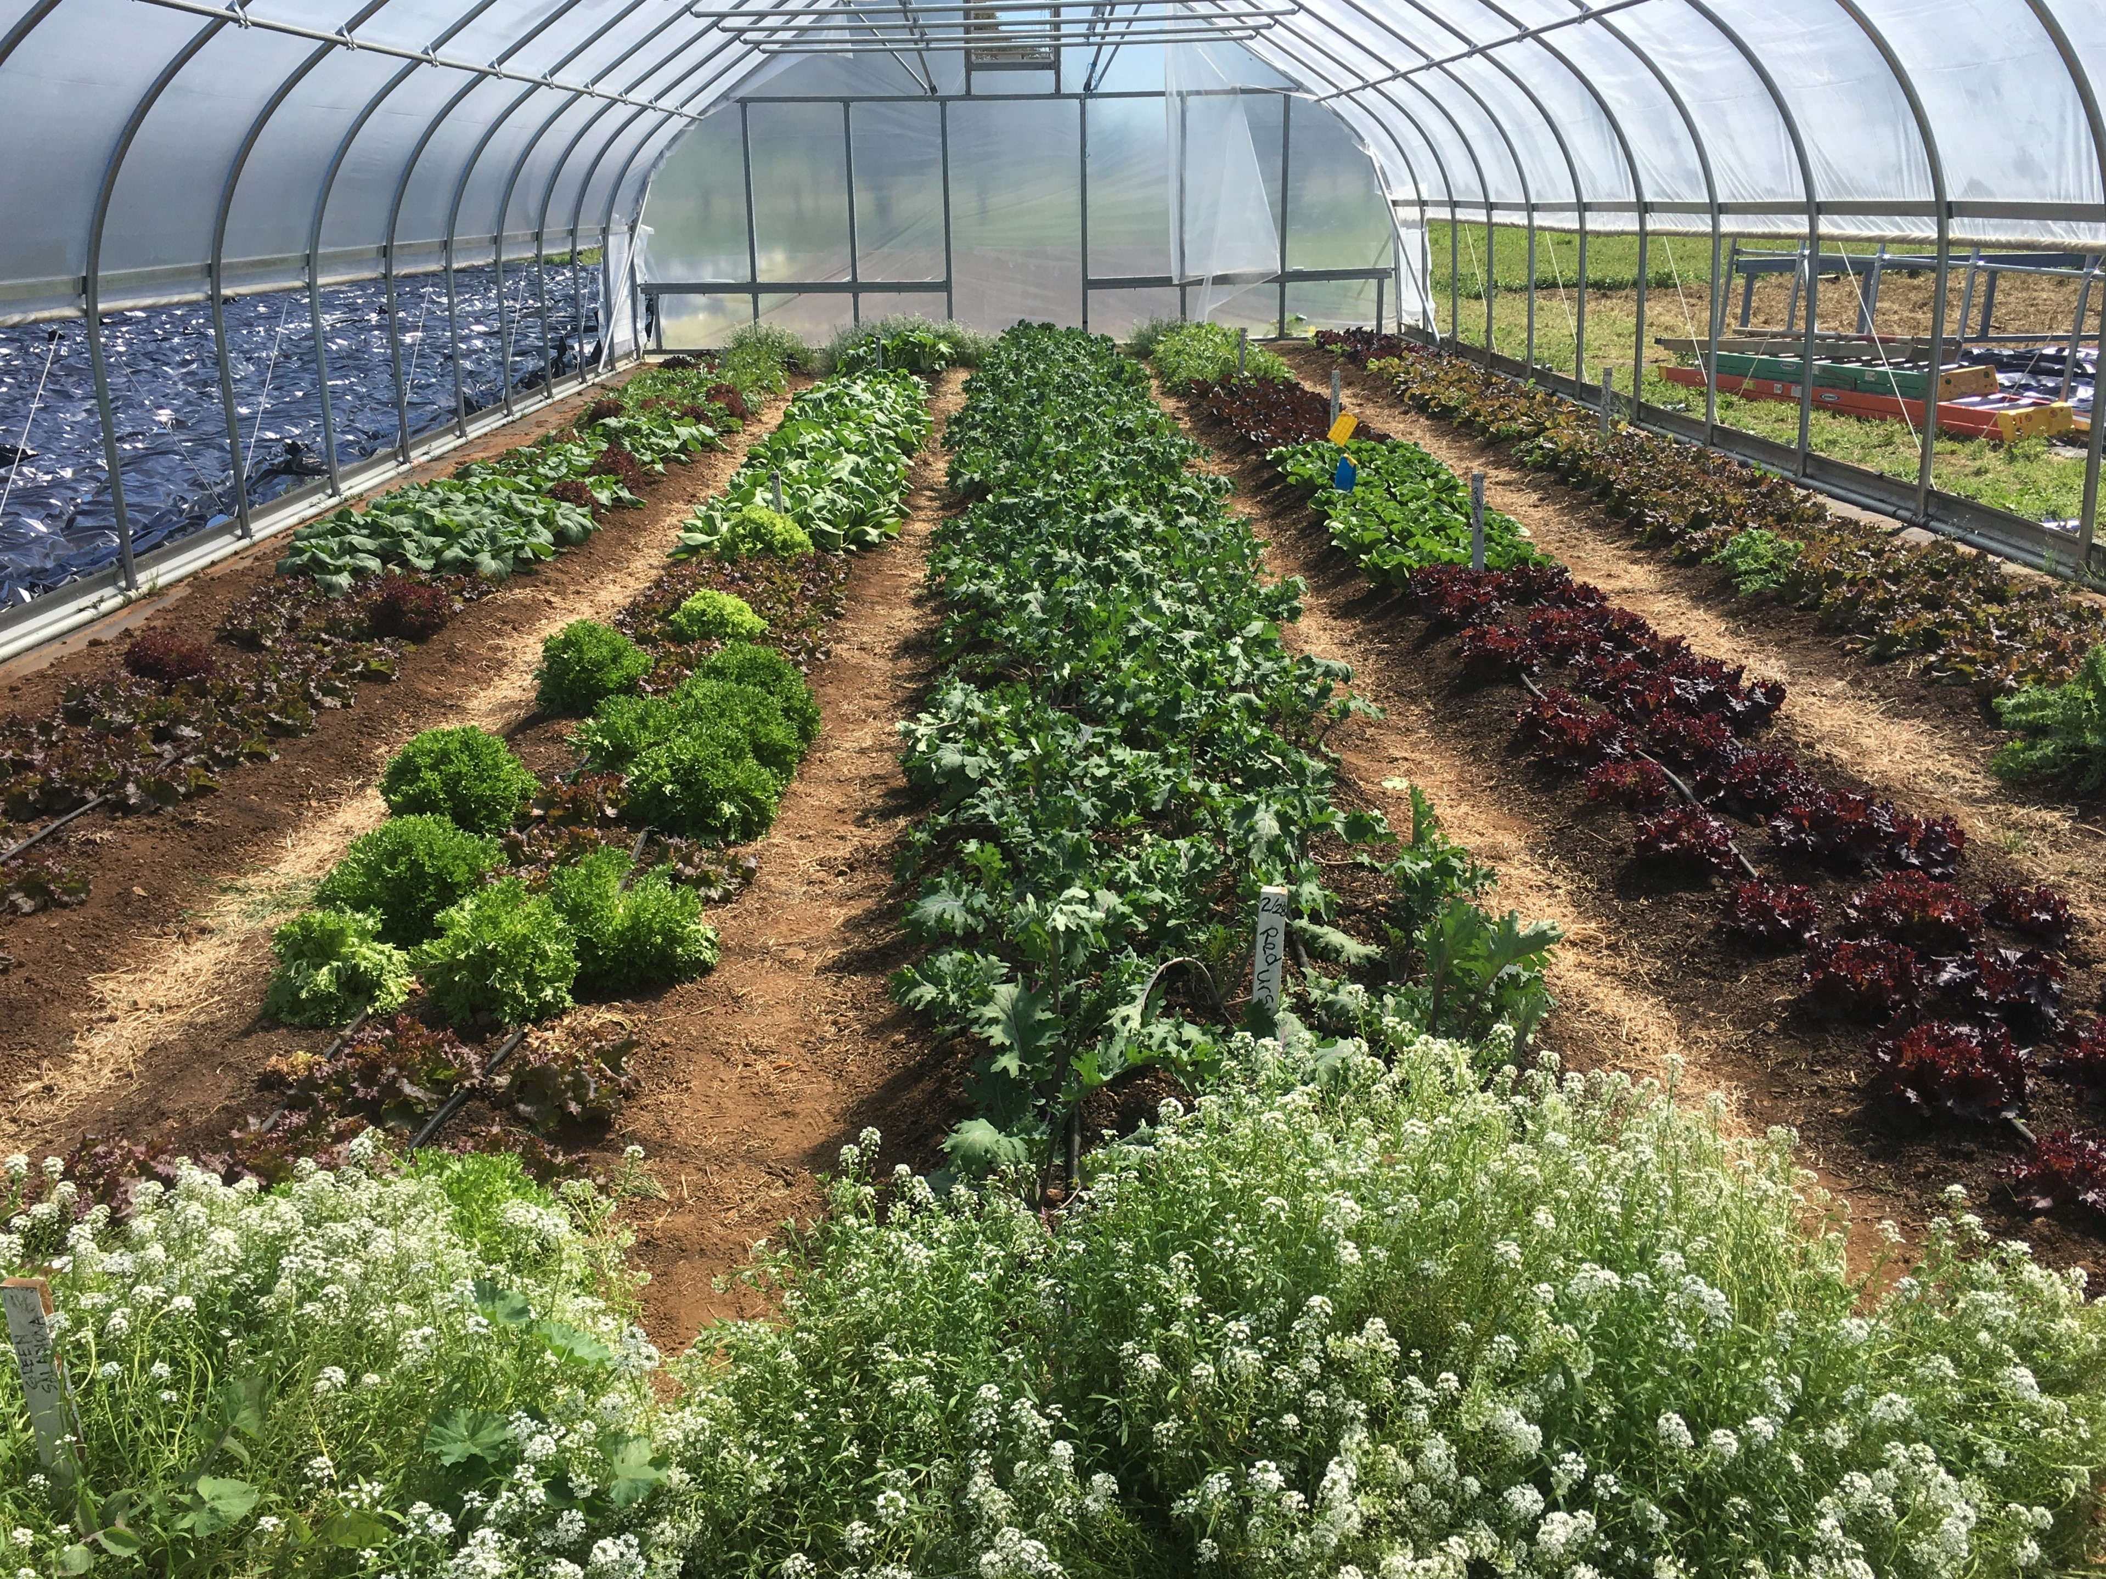
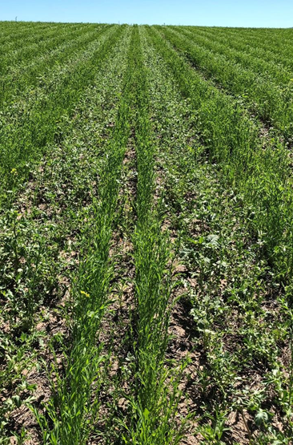
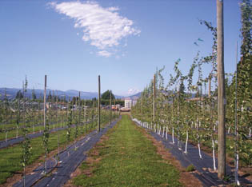
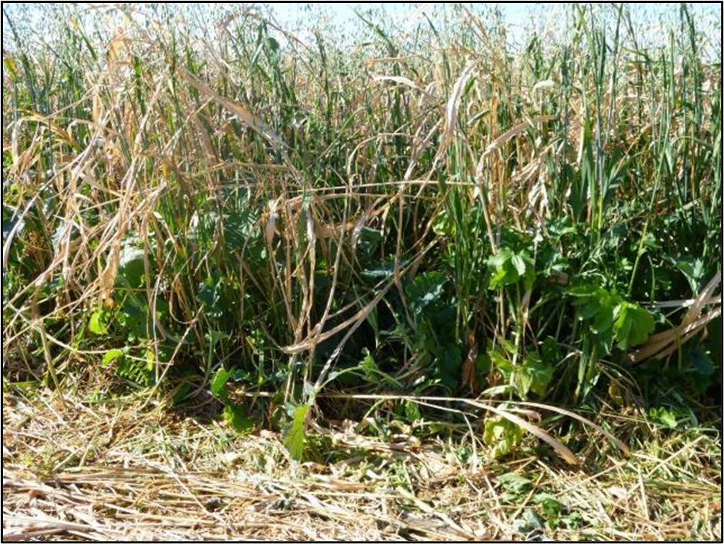
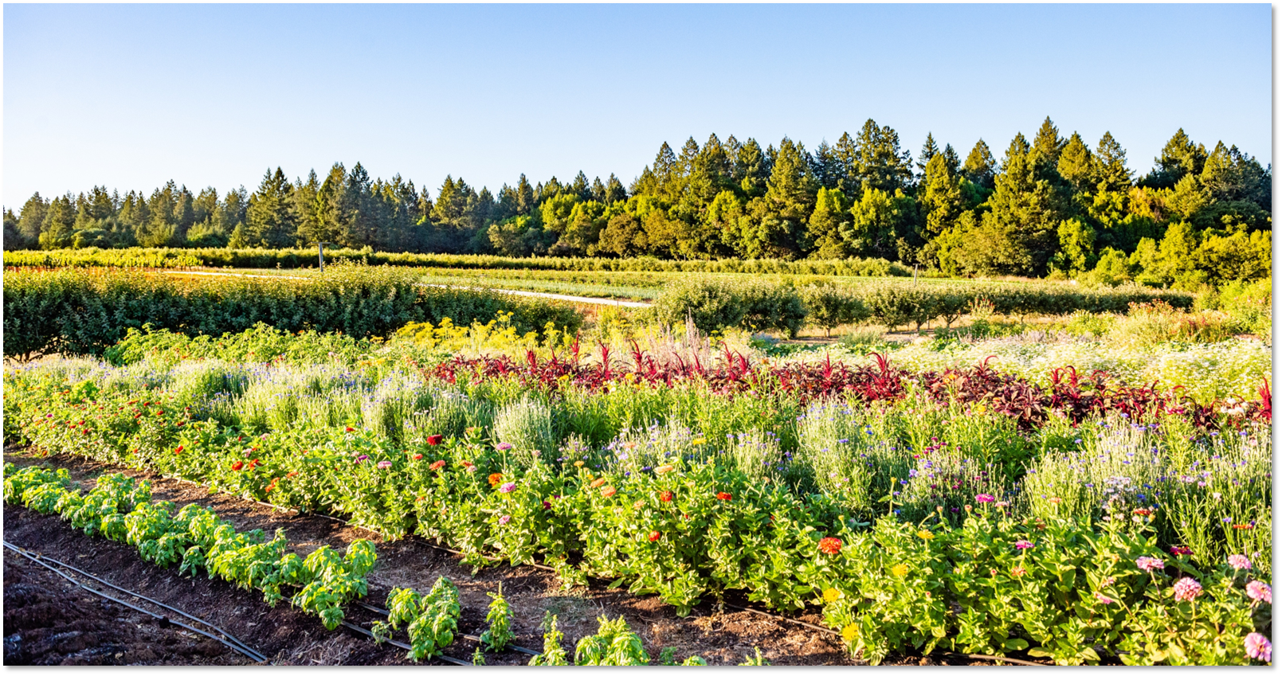
Core Practice Review
Put in photos for urban agriculture
Cons. Crop Rotation (328)
Principles Addressed
  Disturbance
  Cover
  Diversity
  Roots
Conservation Cover (327)
Principles Addressed
  Disturbance
  Cover
  Diversity
  Roots
Cover Crop (340)
Principles Addressed
  Disturbance
  Cover
  Diversity
  Roots
✓
✓
✓
✓
✓
✓
✓
✓
✓
✓
Flax / Chickpeas added to wheat rotation
Notes:
This is an example to evaluate how each practice by itself affects each soil health principle, Not evaluating a RMS system
Cons Crop Rotation Practice Highlights:
Provides diverse root architecture & exudates
↑ Development of diverse soil microbial communities
Breaks disease & pest cycles
↑ nutrient cycling
As a producer adds different crops into the rotation (wheat or small grains) the 328 practice can add cover to a system that may be missing it, for example adding wheat to a corn / bean rotation. Or adding more years of wheat in a wheat / Potato rotation., or corn or wheat added to a peanut / cotton rotation. Cover is also increased when high residue crops are a higher percentage of the rotation.
Conservation Cover Practice Highlights – Like using perennial plants in vineyards or Orchards
Eliminates mechanical soil disturbance, but some disturbance (i.e., grazing, burning) is needed to manage the vegetation that is established.
Provides year-round roots
Keeps the soil covered 365 days a year
Offers a diverse plant community with above & below ground benefits
Cover Crop Practice Highlights
Provides diverse root architecture & exudates
Covers, protects, and adds C to soil during non-cash crop periods, keeps the soil Armored.
Erosion, compaction & weed mgmt. benefits
Adds biological diversity & fix N
Adds of course a diversity of root types (tap or fibrous), Roots of course can explore different regions of the soil, and can add different levels of microbial diversity based on root exudates, maybe associated with AMF.

Slide 18
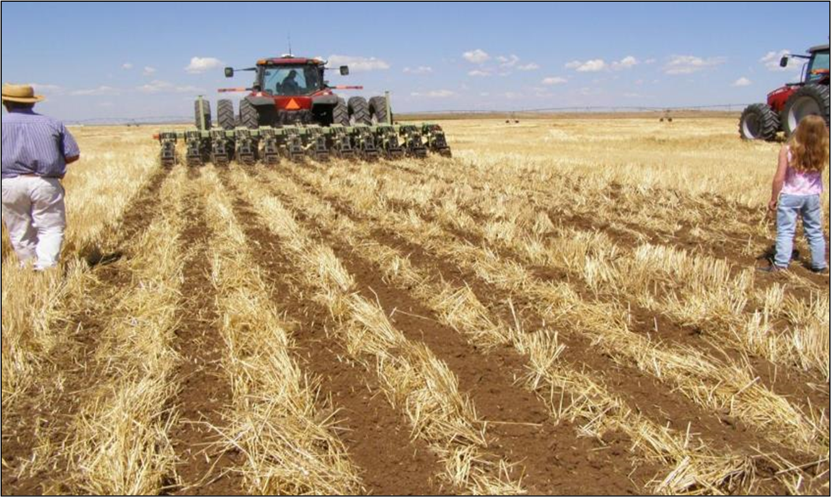
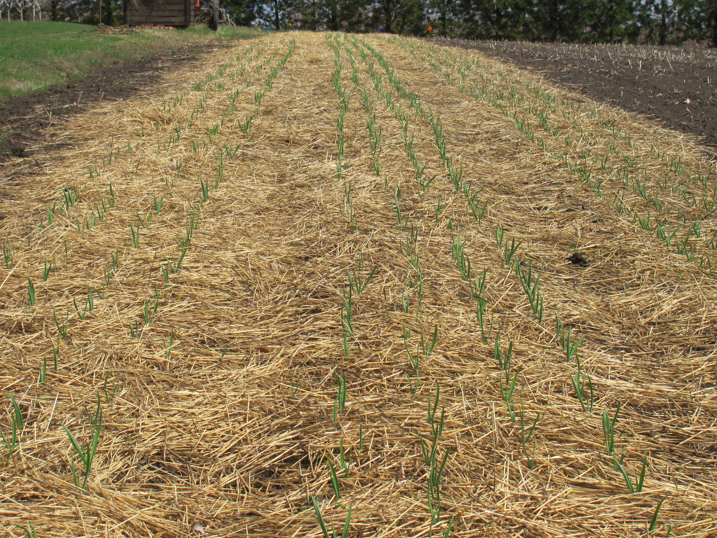
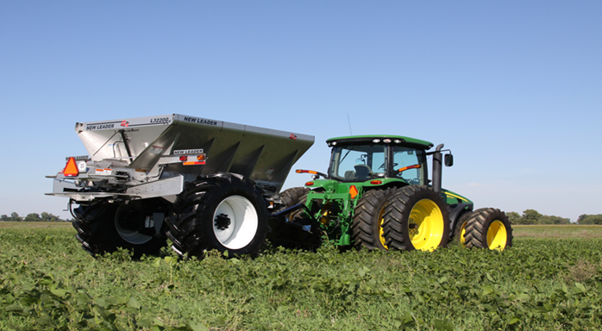
Core Practice Review
Put in photos for urban agriculure
Residue/Tillage Management (329, 345)
Principles Addressed
  Disturbance
  Cover
  Diversity
  Roots
Mulching (484)
Principles Addressed
  Disturbance
  Cover
  Diversity
  Roots
Nutrient Management (590)
Principles Addressed
  Disturbance
  Cover
  Diversity
  Roots
✓
✓
✓
✓
✓
✓
✓
Notes:
Residue Management: check the box on Diversity because minimizing disturbance will improve diversity because you are keeping feed source, cover and also improves habitat for microbes
Mulching is maximizing cover, diversity, and disturbance, by adding mulch which will add a food source, which also improves habitat for soil life. Due to expense of mulching, it needs to remain in place to achieve the benefits desired. Picture is straw mulch in organic garlic production. If mulch is tilled into the soil, then the disturbance check wouldn’t apply.
Nutrient Management:
Low management: Applying high levels of chemical fertilizers
High management: carbon amendments throughout the growing season, as the level of NM management improves and moves to a more biological system. As the system becomes more biological supported diversity of organisms will increase.

Slide 19
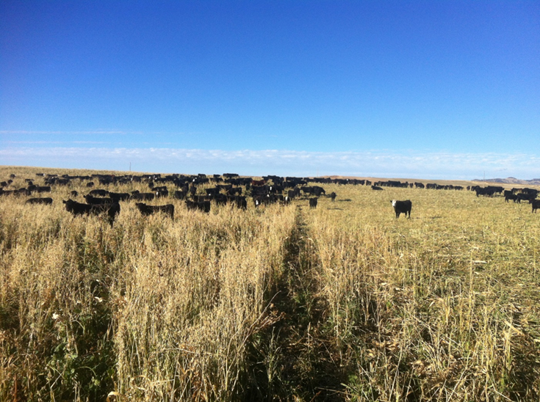
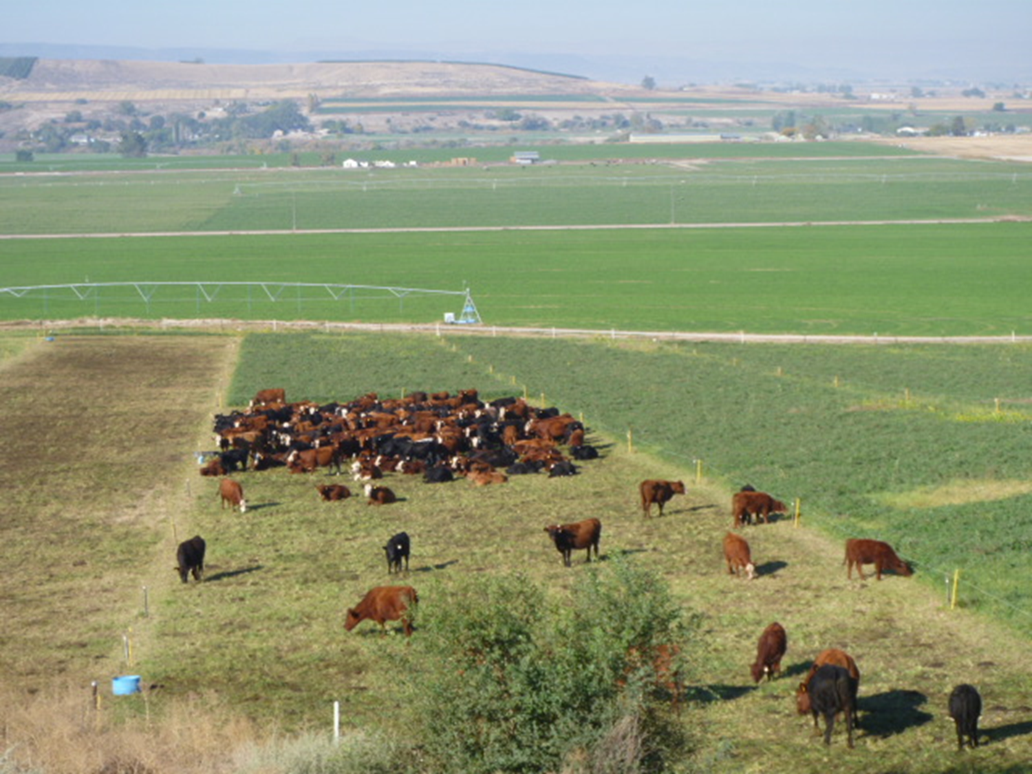
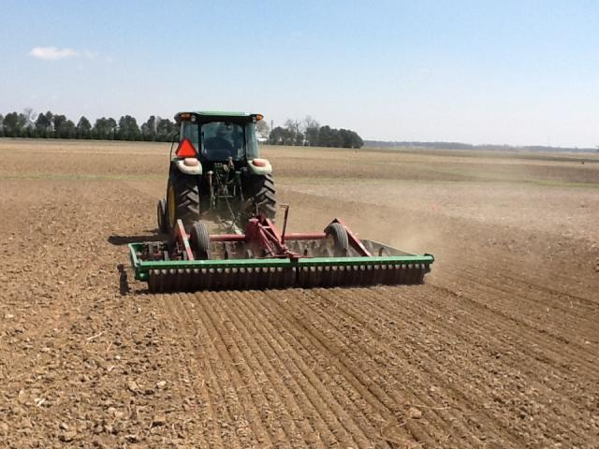
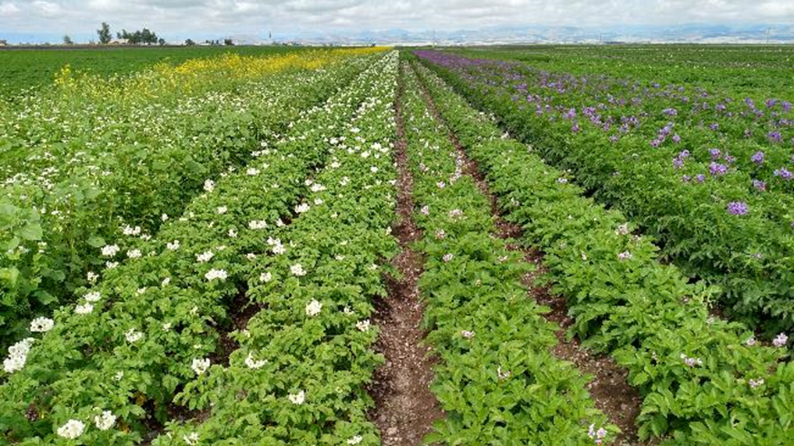
Core Practice Review
Put in photos for urban agriculture
Prescribed Grazing (528)
Principles Addressed
  Disturbance
  Cover
  Diversity
  Roots
Pasture and Hayland Planting (512)
Principles Addressed
  Disturbance
  Cover
  Diversity
  Roots
Integrated Pest Management (595)
Principles Addressed
  Disturbance
  Cover
  Diversity
  Roots
✓
✓
✓
✓
✓
✓
✓
✓
✓
✓
The Ohio State University
Strips of flowering cover crops in potato field
Notes:
Prescribed Grazing Practice Highlights
Manure improves activity & diversity of soil organisms, changes the C:N ration of the plant material,
Managed forage heights promote deeper rooting
Maintains higher levels of residue on the soil surface
Reduces chemical & mechanical disturbance
Pasture and Hay land Planting. Highlights
Disturbance may or may not be checked depending on the method of establishment. During establishment of the pasture or hayland, conventional tillage (plant Bermuda grass springs) is often used which would have negative effect for disturbance in the short term. If the hayland is short lived in the rotation, and tillage is used the take out the hayland and then use tillage again to prepare the seed bed, then maybe you wouldn’t check the box.
AND
Conventional management of hayland would not address the disturbance principle (hayland is usually considered a high disturbance management).
Provides year-round roots
Keeps the soil covered 365 days a year
Offers a diverse plant community with above & below ground benefits
IPM Practice Highlights
Follow the PAMS methodology, which should result in reduction by chemical disturbance associated with over- or mis-use of pesticides
Encourages greater diversity of soil organisms
Pic is a legume root with nodules
On a range land scenario if you have a noxious weed like leafy spurge, utilizing IPM will enhance living roots/ diversity of roots of the native plants

Slide 20
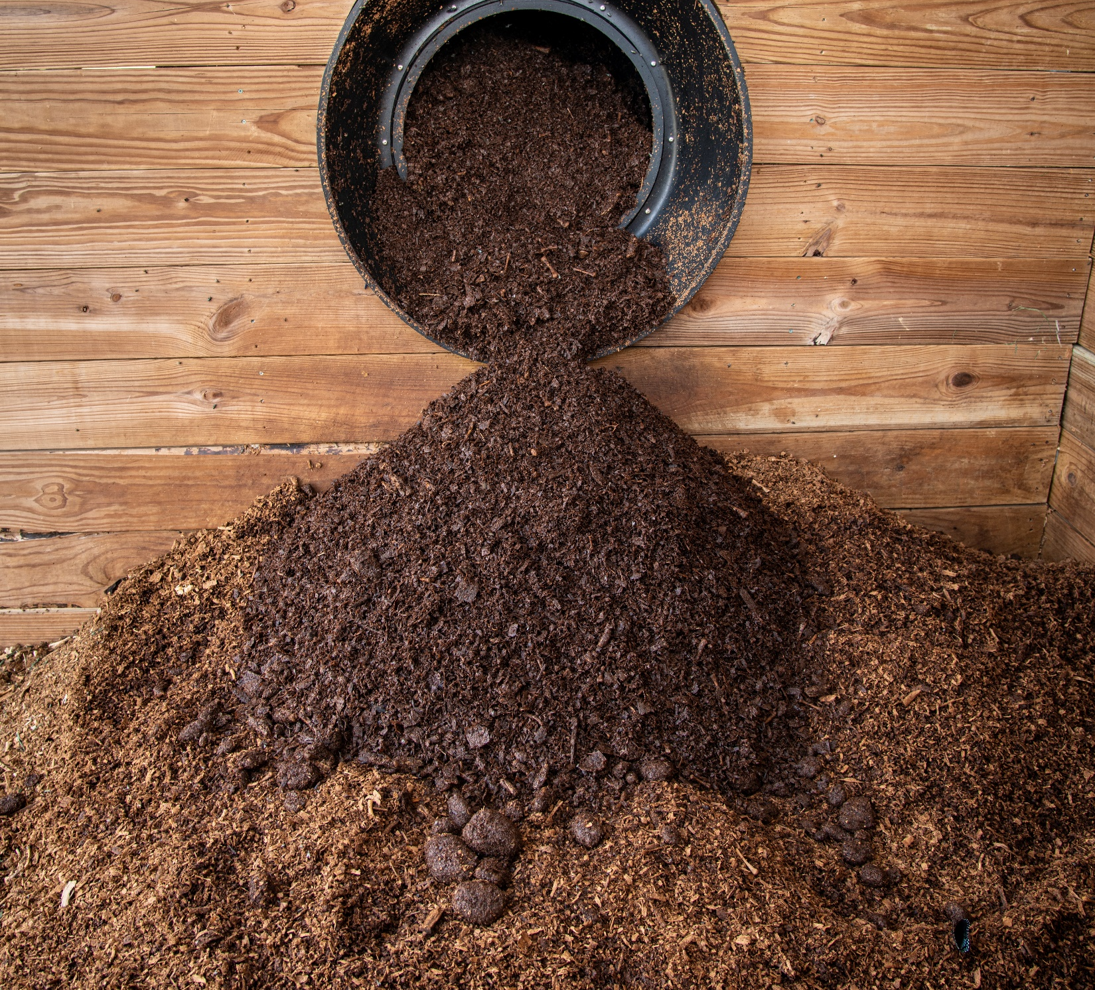
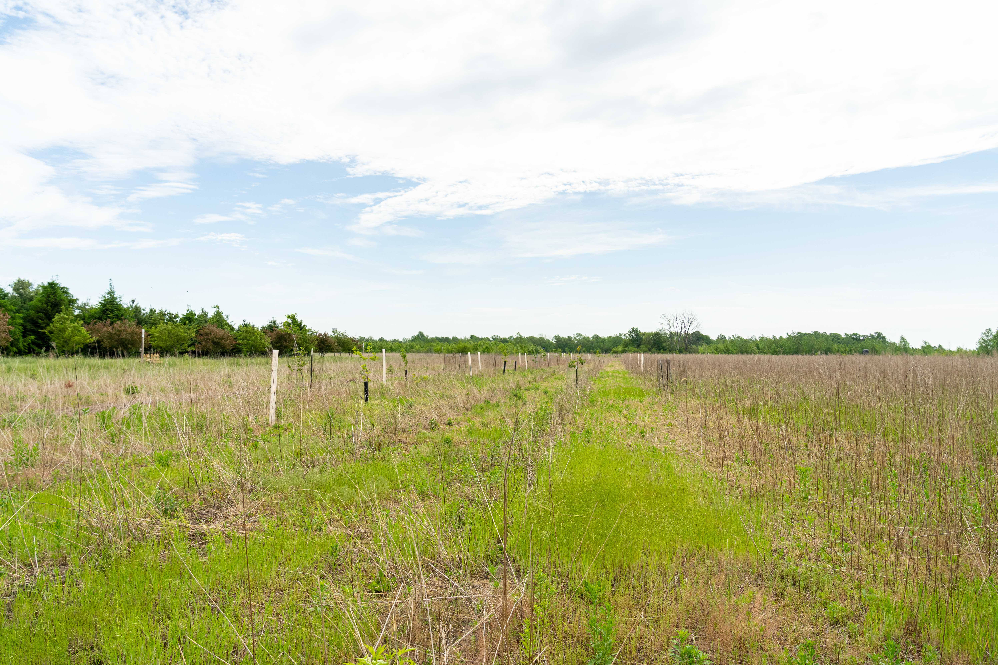
Core Practice Review
Forest Trails and Landings (655)
Principles Addressed
  Disturbance
  Cover
  Diversity
  Roots
Picture of this here
Soil Carbon Amendment (336)
Principles Addressed
  Disturbance
  Cover
  Diversity
  Roots
here
Wildlife Habitat Planting (420)
Principles Addressed
  Disturbance
  Cover
  Diversity
  Roots
Picture of this here
✓
✓
✓
✓
✓
✓
Notes:
Add checks to Distrubance, for 655, 336
Cover, 420
Diversity 336, 420
Root 420
Write why disturbance had highlight (cascading effect) @laura

Slide 21
Discuss Practices in Your Area That Address the Principles
Notes:
7 minutes time : Lead discussion on the practices that are most commonly used in your area (from those listed on slide 7) and consider what principles those practices address. Out of these what would you consider the “core” practices? Discuss again whether the practices they listed treat symptoms of poor soil function or if they address real problems like a soil health management system would.
e.g. terraces treat symptom of aggregate breakdown which results in concentrated flow, notill cover crops, mindful use of inputs, anything that minimizes disturbance will increase aggregation and improve infiltration. Terraces may be needed to fix a large issue but should not be the answer to surface sheet and rill erosion. Forest land =

Slide 22
Soil Health Principles to Support High Functioning Soils
Maximize Living Roots
Minimize Disturbance
Maximize Soil Cover
Maximize
Biodiversity
Feed
Fuel Soil Biology
Improve Resilience
Improve SOM
Protect
Soil Aggregates
Organism Habitat
SOM
Notes:
Utilizing the principles to feed and protect soil biology help to improve soil function, helps to reduce offsite impacts and increase profitability over time with consistent use, some places see benefit in as little as three years with sufficient rainfall, drier climates takes longer up to 10 years with very limited rainfall but it is incremental. Adding animals to the maximizing biodiversity does help speed this impact along.

Slide 23

This information is provided as a public service and constitutes no endorsement by the United States Department of Agriculture or the Natural Resources Conservation Service of any service, supply, or equipment listed.
While an effort has been made to provide a complete and accurate listing of services, supplies, and equipment, omissions or other errors may occur and, therefore, other available sources of information should be consulted
The USDA is an equal opportunity provider and employer.
Meeh, NRCS

